Slide 1

SQL Server DevOps: Getting Started
Scott Sauber
Slides up at scottsauber.com
scottsauber
Notes:
Login to AzDO
Login to AzDo on incognito
Start agent
Open VS Code
Open VS
Deleted extra branches
Pull master
C:\github\talks\sql-server-devops-recording\Recorded SQL DevOps
DROP TABLE IF EXISTS [ASiteToOrderStuff-Flyway-Dev].dbo.flyway_schema_history
DROP TABLE IF EXISTS [ASiteToOrderStuff-Flyway-Prod].dbo.flyway_schema_history
DROP TABLE IF EXISTS [ASiteToOrderStuff-Flyway-Dev].dbo.Quantities
DROP TABLE IF EXISTS [ASiteToOrderStuff-Flyway-Prod].dbo.Quantities

Slide 2

Audience
Developers + DBA’s who want to automate their SQL Server builds and deployments
Unsure where to get started
scottsauber

Slide 3
Agenda
What choices do I need to make?
What are the tradeoffs?
What tools are out there?
What hurdles will I face?
Demos
Questions
scottsauber

Slide 4
Purpose
Ramp up on how to implement automation to your SQL Server
Know the options and tradeoffs of different approaches and tools
scottsauber

Slide 5
Who am I?
Software Consultant at Sauber Software
Developer (not a DBA) and big proponent of DevOps
Successfully implemented SQL DevOps Pipelines for over 50 db’s
Including 25 year old SQL Server db
scottsauber
Notes:
25 year old DB that was multi-tenant where each customer had their own DB instances, each DB had thousands of DB objects, stored procedures that used Linked Servers, dead stored procedures referencing removed columns, etc.

Slide 6
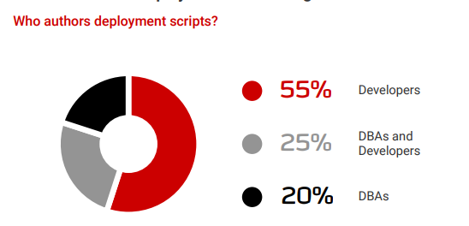
Types of team interactions with DB’s
Devs write, review, and deploy the SQL. No dedicated DBA.
Devs write the SQL and give to DBA to review and deploy.
Devs tell DBA’s what they want, DBA’s write, review and deploy the SQL.
scottsauber

Slide 7
What a manual workflow may look like today
Compare approach (i.e. Redgate SQL Compare)
Developer/DBA works on a development DB
That DB is then compared to a Prod or Prod-like DB to compare changes
Tool generates script to deploy
Script is deployed to Prod
SQL Script approach
Developer/DBA works on a development DB
Developer/DBA accumulates scripts
Developer/DBA runs scripts against Prod
scottsauber

Slide 8
What’s wrong with these approaches?
No Source Control
No traceability
No easy rollbacks
Manual
Tedious
Easy for mistakes
Script order can get out of whack
Development DB + Prod DB could be out of sync
Changes in behavior
Overwriting others (sprocs, views)
Hard to pull in others changes (no forced CI)
scottsauber

Slide 9
What is DevOps?
“DevOps is the union of people, process, and products to enable continuous delivery of value to our end users.”
- Donovan Brown

Slide 10
What is DevOps?
“DevOps is the union of people, process, and products to enable continuous delivery of value to our end users.”
- Donovan Brown

Slide 11
What is DevOps?
“DevOps is the union of people, process, and products to enable continuous delivery of value to our end users.”
- Donovan Brown

Slide 12
What is DevOps?
“You can’t change culture and process with a credit card.”
- Julie Gunderson

Slide 13
Desired Outcomes of SQL Server DevOps Pipelines
In order of importance:
Database is source controlled
Database deployments are at most a single click of a button
Database builds for verification on each commit
Monitor production database for out-of-band changes
This one is fun because people.
scottsauber
Notes:
This one is fun because the people who need to implement the monitoring are the ones who are the only ones who can make changes to production.

Slide 14
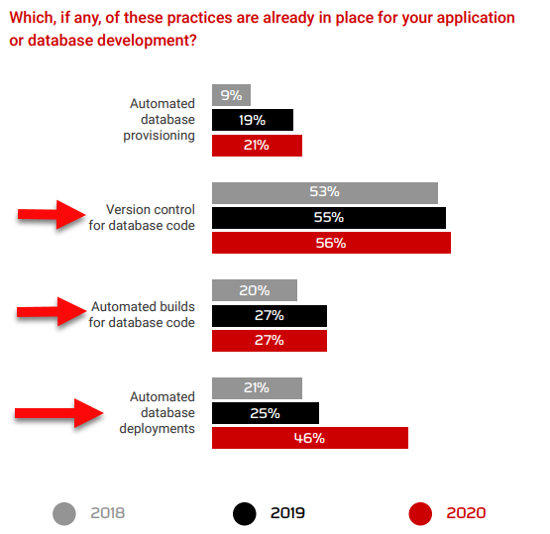
scottsauber

Slide 15
Why is this hard?
Source Control traditionally not built-in to SQL Server tools (SSMS)
Sins have been committed in your legacy databases over time
Linked servers, DB hopping, no named defaults
Requires Devs + DBA’s to talk to each other
DBA’s think they are getting cut out
Spoiler: they’re not. The crappy part of their job is, so they can do more value add work.
Redgate article on “Implementing DevOps Doesn’t Get Rid Of Database Administrators”
scottsauber

Slide 16
Why is this hard?
The database is stateful, applications are not (or shouldn’t be.)
Rollback of an app is “delete all these files and replace them with these ones….”
Rollback of a database requires thought
scottsauber

Slide 17
Let’s get to DevOpsing
scottsauber

Slide 18
Source Control: What do I source control?
Schema Structure
Tables, Views, Stored Procedures, etc.
Static Data
Data required for the application to run successfully
Lookup Tables, Roles table for users in a system, Configuration values, etc.
scottsauber

Slide 19
Source Control: How? Migration-based
Every change is scripted
Scripts are committed to source control
Scripts run in order (date-based or #-based)
Which scripts have run are kept track in a table
Write them up front during dev
Run the same scripts in every environment
Examples of tools: Redgate SQL Change Automation (hybrid), Flyway, DbUp, and RoundhousE
Migration-based is my preferred approach
scottsauber
Notes:
Running the same script in every environment increases the likelihood of a successful Production deployment. If the exact same set of scripts works in every other environment prior to Production, that can give you a lot of confidence that it will work in Production as well.
This is one of the reasons that the “Compare” method I mentioned earlier fails. Often you are running a deployment for the first time so who knows if you remembered to deploy everything.

Slide 20
Source Control: How?
Database Code + Application Code should live together in the same Source Control Repository
One Pull Request/Commit/Checkin for the application code and SQL code
Ideally Final Schema and Migrations live together
scottsauber

Slide 21
Tool Review: Flyway
Open source
Migration-based approach
Command line tool
scottsauber

Slide 22
Flyway Demo
Demo
Config
Baseline
Migrate
scottsauber

Slide 23
Tool Review: Redgate SQL Change Automation
Also supports showing the final state of your application
Not used for deployment
Visual Studio and SSMS Extension
Make changes in DB, use Extension to get those changes as migration scripts
Builds your DB from scratch as a dry-run
Integrates with MSBuild, Azure DevOps, TeamCity, and Octopus Deploy
scottsauber

Slide 24
Automated Builds: How?
Responsibilities:
Take migrations and deploy them to an independent DB
Spin up new DB or have dedicated CI DB
Use a Build tool
Azure DevOps
Jenkins
TeamCity
GitHub Actions
Bamboo
Concourse
scottsauber

Slide 25
Automated Deployments: How?
Responsibilities:
Deploy to each Environment
Swap out secrets (i.e. connection strings)
Use Deployment tool
Octopus Deploy
Azure DevOps
Jenkins
TeamCity
GitHub Actions
Bamboo
Concourse
scottsauber

Slide 26
Proposed Workflow
Developer adds their application code and SQL code
Developer commits to a branch and sends a Pull Request for code review
Another developer reviews the application code
DBA/senior person reviews SQL code
When both are approved, the code is merged into master
Code is built independently to verify the commit
Deployments are then a button push
scottsauber

Slide 27
Workflow Demo
Demo
Add Migration
Reviewed by DBA/senior person
Build server
Deploy changes to databases
Promote through environments
scottsauber

Slide 28
Tool Review: Redgate DLM Dashboard
Monitors and alerts on SQL Server schema changes
Audit history of changes
Finds when someone bypasses the pipeline
scottsauber

Slide 29
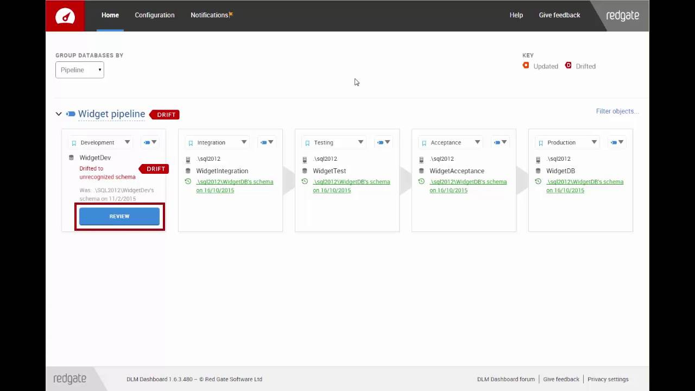
scottsauber

Slide 30
Common Gotcha’s Building The Database
You will pay for the sins of your ancestors
Linked Servers
Cross-Database Hopping
Fully qualified Database Names
No named column defaults
Old Stored Procedures or Views Referencing Old Tables/Columns
Temp Table creation in Stored Procedures
scottsauber

Slide 31
A Word On Rollbacks
They are usually not worth the headache
Why did the deployments succeed in Dev, UAT, etc. but not in Production?
Almost always a failure in people and/or process
How do you rollback something destructive (DROP, DELETE, TRUNCATE, etc.)?
Contextual
Tradeoffs
Restore from backup but lose data in between deployment and restore.
Instead: Roll forward
scottsauber

Slide 32
People Challenges
Mindset shift
The more you can force “no one has Prod” access the better
Force everything to go through the pipeline.
No “I’ll just do this one little thing…”
Devs + DBA’s Need To Work Together
Customer focus
scottsauber
Notes:
Devs + DBA’s n

Slide 33
Takeaways
Choose a migrations-based approach
Source Control your DB
Auto Deploy the Source Controlled Migrations
Tools you can use
Gotcha’s – tools, existing DB sins, and people
You can do this – the question is, does your organization want to?
scottsauber

Slide 34
Resources
Redgate Simple Talk Blogs
Redgate Database DevOps Blogs
Redgate 2020 State of DevOps Survey
Redgate Training on SQL Change Automation
Redgate YouTube Channel on SQL Change Automation
DB DevOps with Jeffrey Palermo and Paul Stovell
Slides at scottsauber.com
scottsauber

Slide 35

Questions?
Slides at scottsauber.com
scottsauber

Slide 36
Thanks!
Slides at scottsauber.com
scottsauber

